Slide 1
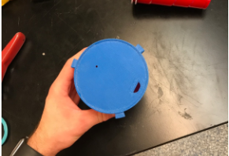

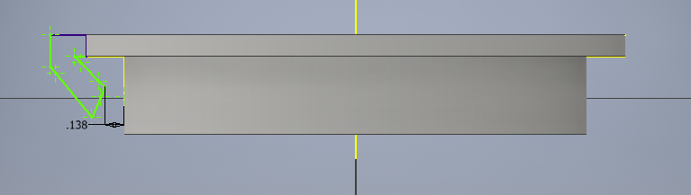
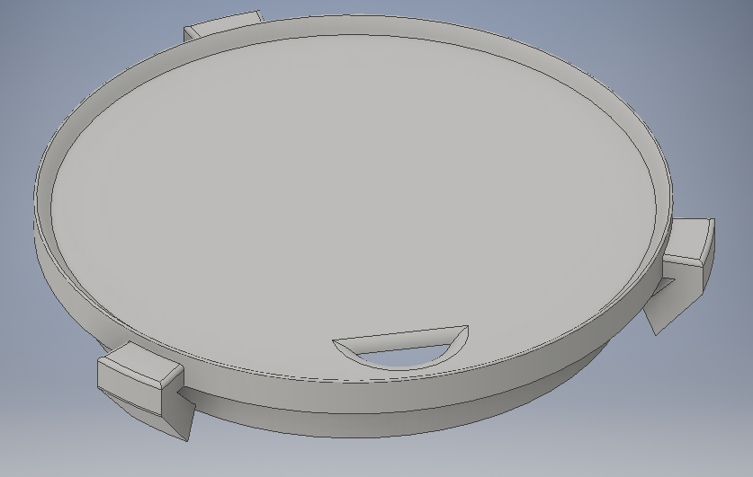
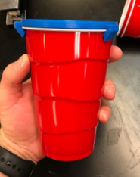
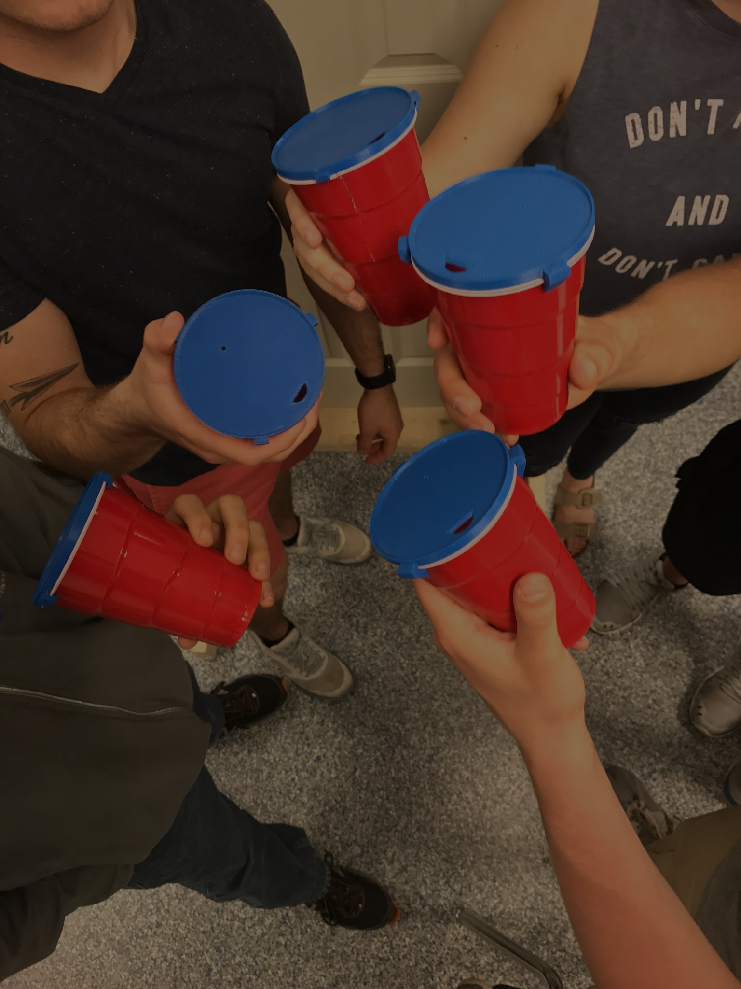
Helps with binge drinking, and helping prevent doctored drinks
Design Considerations
3D Printed
“Fish-Hook” Corner
Leak Proof
Reduced Surface Area by 99.64%
Protects Against Drink Spiking Area<0.05 in²
Limits Alcohol Intake Secure Lid Liquid Tight Seal
Notes:
https://www.nbcnews.com/feature/college-game-plan/drink-spiking-college-may-be-more-common-thought-n581881

